Slide 1
Link Aggregation
Using PAgP and LACP
By Sam Nishanth . K
RegNo : 124004265

Slide 2
Outline
Introduction
Spanning Tree Protocol
Link Aggregation
Etherchannel
Protocols for Link Aggregation(LACP and PAgP)
Advantages
Project Design
Bandwidth Improvement
Conclusion

Slide 3
Introduction
Redundant links between switches is a good idea because they help prevent complete network failures in the event one link stops working. However, they often cause more problems because frames can be flooded down all redundant links simultaneously, this creates network loops.
A looped topology is often desired to provide redundancy, but looped traffic is undesirable. The Spanning-Tree protocol was originally designed for bridges. Today, it is also applied to LAN switches and routers operating as a bridge. Spanning-Tree protocol ensures that all bridged segments are reachable but any points where loops occur will be blocked.

Slide 4
Spanning Tree Protocol
Networks are often configured with redundant paths when connecting network segments. Although redundancy can help protect against disaster, it can also lead to bridge or switch looping. Looping occurs when data travels from a source to a destination along redundant paths and the data begins to circle around the same paths, becoming amplified and resulting in a broadcast storm.
STP can help prevent bridge looping on LANs that include redundant links. Without STP, it would be difficult to implement that redundancy and still avoid network looping. STP monitors all network links, identifies redundant connections and disables the ports that can lead to looping.

Slide 5
Spanning Tree Protocol
Some of the terms used in Spanning-Tree Protocol
BPDU Bridge Protocol Data Unit (BPDU) — All the switches exchange information to use in the selection of the root switch
Bridge ID — The bridge ID is how STP keeps track of all the switches in the network. It is determined by a combination of the bridge priority (32,768 by default on all Cisco switches) and the base MAC address.
Root Bridge -The bridge with the lowest bridge ID becomes the root bridge in the network.
Nonroot bridge — These are all bridges that are not the root bridge.
Root port — The root port is always the link directly connected to the root bridge or the shortest path to the root bridge. If more than one link connects to the root bridge, then a port cost is determined by checking the bandwidth of each link.
Designated port — A designated port is one that has been determined as having the best (lowest) cost. A designated port will be marked as a forwarding port
Nondesignated Port — A nondesignated port is one with a higher cost than the designated port. Nondesignated ports are put in blocking mode
Forwarding Port — A forwarding port forwards frames
Blocked Port — A blocked port is the port that will not forward frames, in order to prevent loops

Slide 6
Drawback
One of the drawbacks of an STP is that in blocking redundant ports and paths, a spanning tree reduces the aggregate available network bandwidth significantly. Additionally, STP can result in circuitous and suboptimal communication paths through the network, adding latency and degrading application performance.

Slide 7
Bandwidth of a channel can be increased by
Replacing the existing link with a higher speed link.
Add more redundant paths.
Implementation of ETHERCHANNEL for Link Aggregation.

Slide 8
Best Way to increase Bandwidth:Etherchannel
Can be used with existing Switch ports
Does not require much configurations on individual links as most configurations on a Etherchannel is a preset.
Provides load balancing

Slide 9
Link Aggregation
Wired methods of Networking are proven more effective than wireless. But while networking, it’s troublesome to manage many wires at once. To solve this problem, link aggregation plays a vital role. since it’s known to carry multiple ports collectively as a single channel. In other words, link aggregation combines multiple physical ports as one port, which makes it easy to carry out the task by the user. Also, it makes the process cost-effective.

Slide 10
What is a Etherchannel ?
EtherChannel is a technology that was originally developed by Cisco as a LAN switch-to-switch technique of grouping several Fast or Gigabit Ethernet ports into one logical channel and redundancy without being blocked by the Spanning Tree Protocol. EtherChannel configuration has one mode known as the On mode. On mode forces the connection to bring all links up without using a protocol to negotiate connections. This mode can only connect to another device that is also set to on. When using this mode, the switch does not negotiate the link using either PAgP or LACP.

Slide 11
Requirements for etherchannel
Ports must have same duplex.
Channels with same speed.
All ports must be either an Acess port or a Trunk port.

Slide 12
Protocols for Link Aggregation
LACP
LACP is an IEEE standard, which is a part of the IEEE 802.3 ad specification. LACP Ether Channel can be configured with a maximum of 16 Ethernet ports of the same kind. In that case, only up to eight links in the Link Aggregation Group will be activated, while the remaining eight links will be on standby mode.
In the process, link aggregation takes place through two different modes, Active or Passive. Both are briefly explained below:
Active: To form an LACP connection, this interface keeps sending packets actively.
Passive: On the other hand, in the passive mode, the interface can give a response to LACP, but cannot initiate itself.

Slide 13
Protocols for Link Aggregation
PAgP
Port Aggregation Protocol (PAgP) provides the same negotiation benefits as LACP. PAgP is a Cisco proprietary protocol, and it will work only on Cisco devices. PAgP packets are exchanged between switches over EtherChannelcapable ports. PAgP also has 2 modes Auto and Desirable.
• Auto mode sets the interface to respond to PAgP negotiation packets, but the interface will not start negotiations on its own.
• Desirable mode sets the interface to actively attempt to negotiate a PAgP connection.

Slide 14
Benefits of Link Aggregation
Increased Bandwidth: Use EtherChannel and combine two or four links into one logical link. It will double or quadruple your bandwidth. For example, four 100Mb Fast Ethernet connections bonded into one could provide you up to 800Mb/second, full duplex.

Slide 15
Benefits of Link Aggregation
Provides Redundancy: Since there are many Ethernet links combined into one logical channel, it automatically allows more available links in case one or more links go down.

Slide 16
Benefits of Link Aggregation
Load Balance Traffic: EtherChannel balances the traffic load across the links, thereby increasing efficiency on your networks.

Slide 17

Platform Used
Cisco Packet Tracer

Slide 18
Design of the Project
Take for example 6 PCs and 3 Switches, assign IP addresses to the PCs
PC0 : 192.168.10.100
PC1 : 192.168.20.100
PC2 : 192.168.10.150
PC3 : 192.168.20.150
PC4 : 192.168.10.120
PC5 : 192.168.20.120

Slide 19
Connecting PCs with the switches
Connect PC0 to FE 0/1 of S1
Connect PC1 to FE 0/10 of S1
Connect PC2 to FE 0/1 of S2
Connect PC3 to FE 0/10 of S2
Connect PC4 to FE 0/1 of S3
Connect PC5 to FE 0/10 of S3

Slide 20
Adding connection between switches (Trunk links) (Redundant links)
GE 0/1-2 of S1 connected to GBE 0/1-2 of S2.
FE 0/21-24 of S2 connected to FE 0/21-24 of S3
FE 0/17-19 of S3 connected to FE 0/17-19 of S2

Slide 21
Configuring etherchannel between switches
We need to configure the ports used in a Switch to create a Etherchannel either staticly(Manually) or by using the LACP or PAgP , Hence creating an Aggregated channel or an Etherchannel between 2 switches and hence increasing the efficiency of the existing links between the switches

Slide 22
Command line interface code for switch 1
enable
configure terminal
interface range gigabitethernet 0/1-2
channel-group 1 mode active
interface range fastethernet 0/17-19
channel-group 3 mode on

Slide 23
Command line interface code for switch 2
enable
configure terminal
interface range gigabitethernet 0/1-2
channel-group 1 mode passive
interface range fastethernet 0/21-24
channel-group 1 mode auto

Slide 24
Command line interface code for switch 3
enable
configure terminal
interface range fastethernet 0/21-24
channel-group 1 mode desirable
interface range fastethernet 0/17-19
channel-group 1 mode on

Slide 25
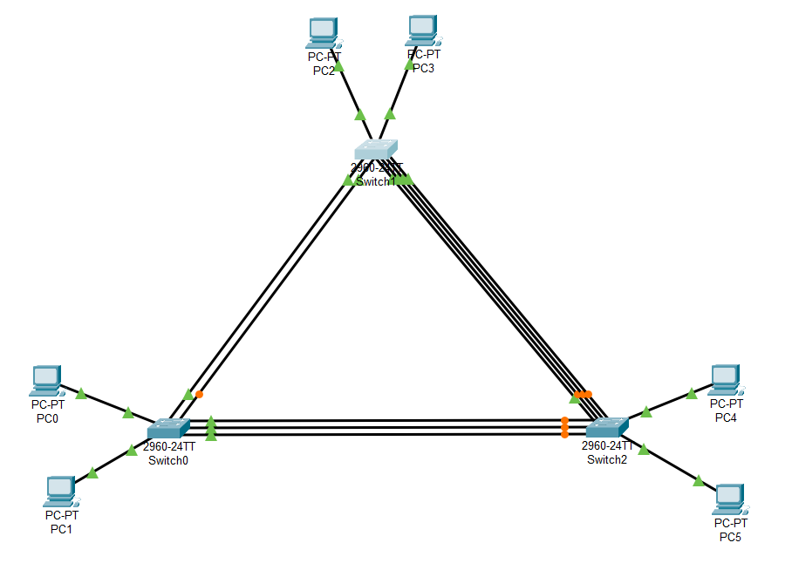
Pre configuration
The SPT protocol assigns Root Bridge,
Nonroot bridge, Root port, Designated port,
Nondesignated Port, Forwarding Port
Blocked Port .
This in turn reduces the overall utilization of the available channels as blocked ports are no more used to transfer packets.

Slide 26
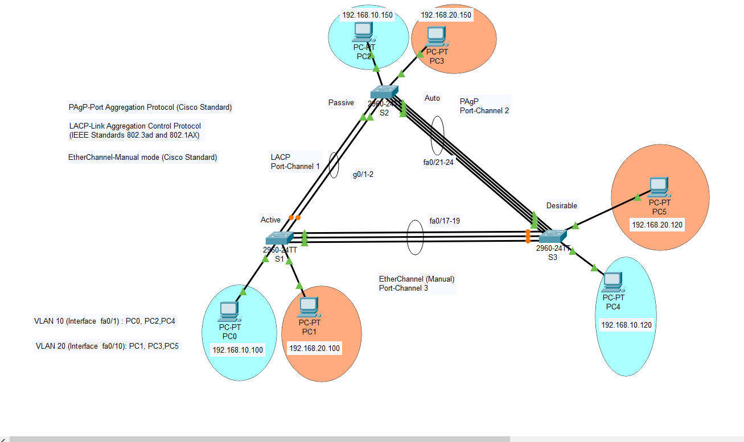
Post configuration
Every port connected between the switches are now utilized as the existing links between the switches are now aggregated as one interface which appears in the SPT as a single channel rather than looped links.

Slide 27
Bandwidth before configuration
Bandwidth Between S1 and S2- 1000 Mbps
Bandwidth Between S2 and S3- 100Mbps
Bandwidth Between S3 and S1- 100 Mbps

Slide 28
Bandwidth After Configuration
Bandwidth Between S1 and S2- 2000 Mbps
Bandwidth Between S2 and S3- 400 Mbps
Bandwidth Between S3 and S1- 300 Mbps

Slide 29
Conclusion
Configuration tasks can be done on the EtherChannel interface instead of on each individual port, ensuring configuration consistency throughout the links.
The loss of one physical link within the channel does not create a change in the topology; therefore a spanning tree recalculation is not required.
There is no need to upgrade the link to a faster and more expensive connection to have more bandwidth.

